Slide 1
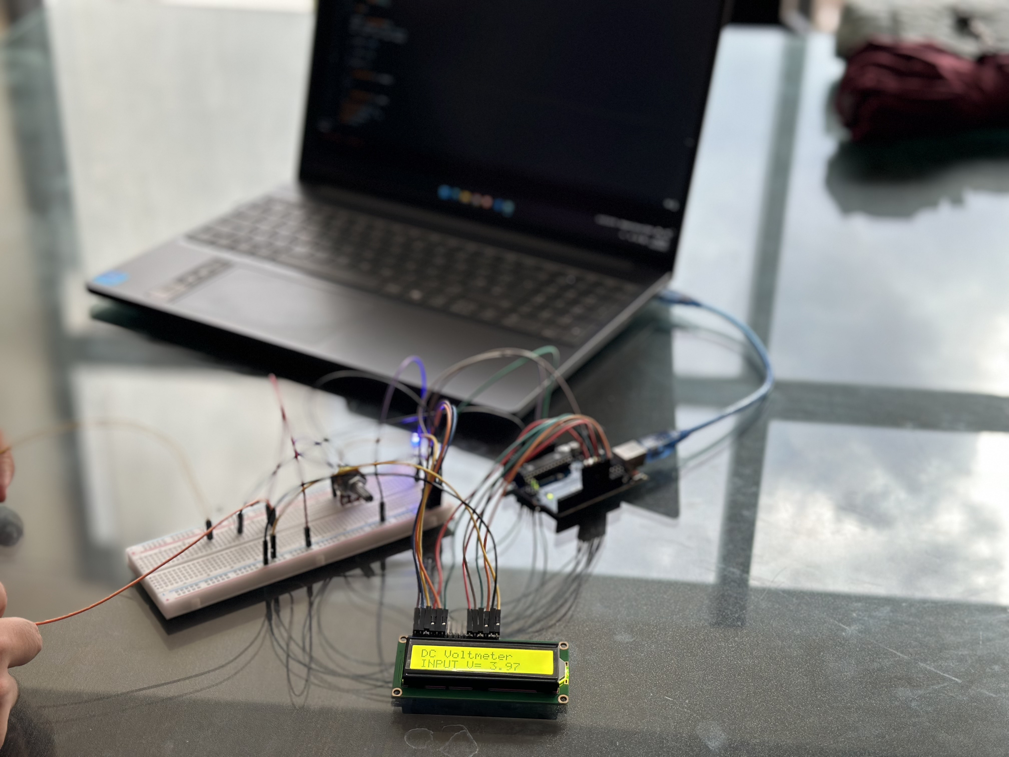
Digital Voltmeter Using Arduino and LCD Display
Presented by Group 1

Slide 2
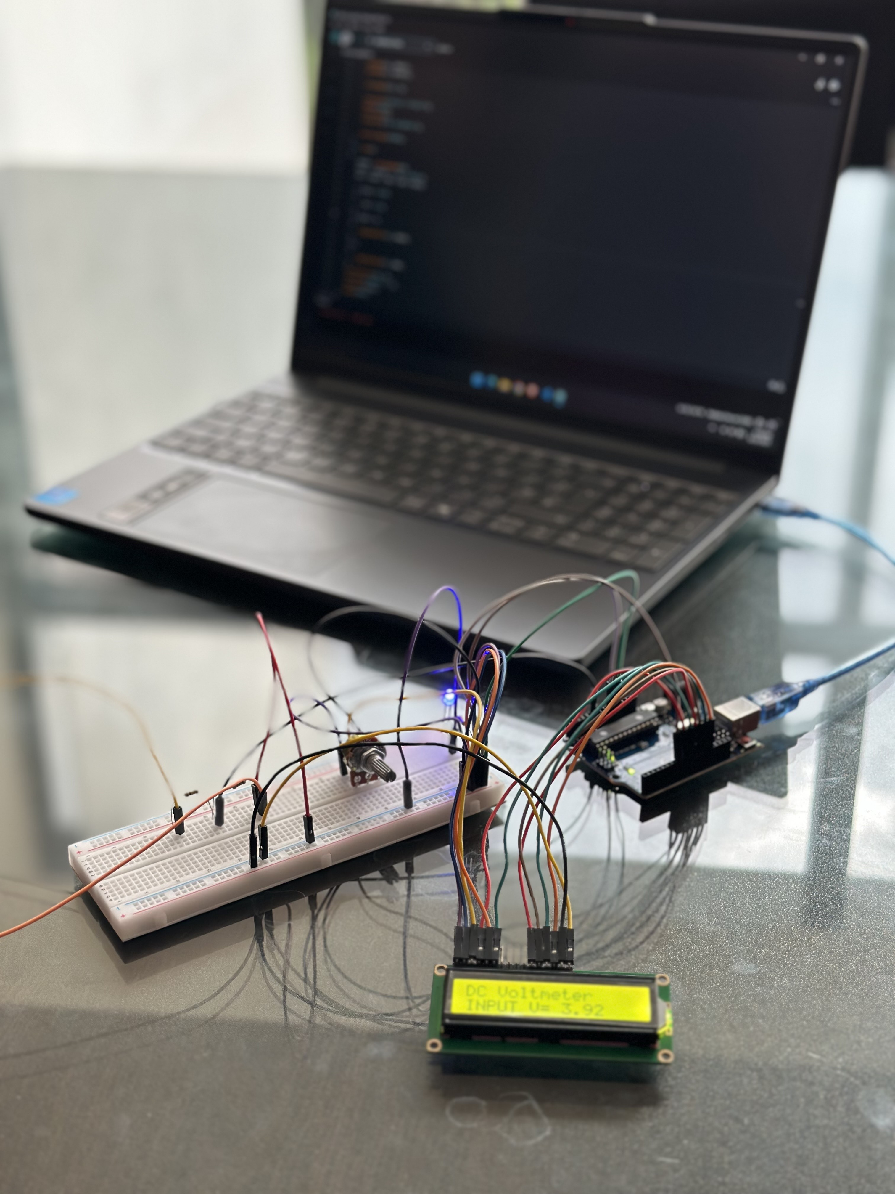
Executed by:
202516060 - Abdullah Al Kafi
202516067 - Mst. Sanjana Afrin Tanha
202516071 - Hasin Ishraq Khan
202516073 - Muhammad Labib Daiyan Bhuiyan
202516077 - Md. Rowshon Jamil Anondo

Slide 3
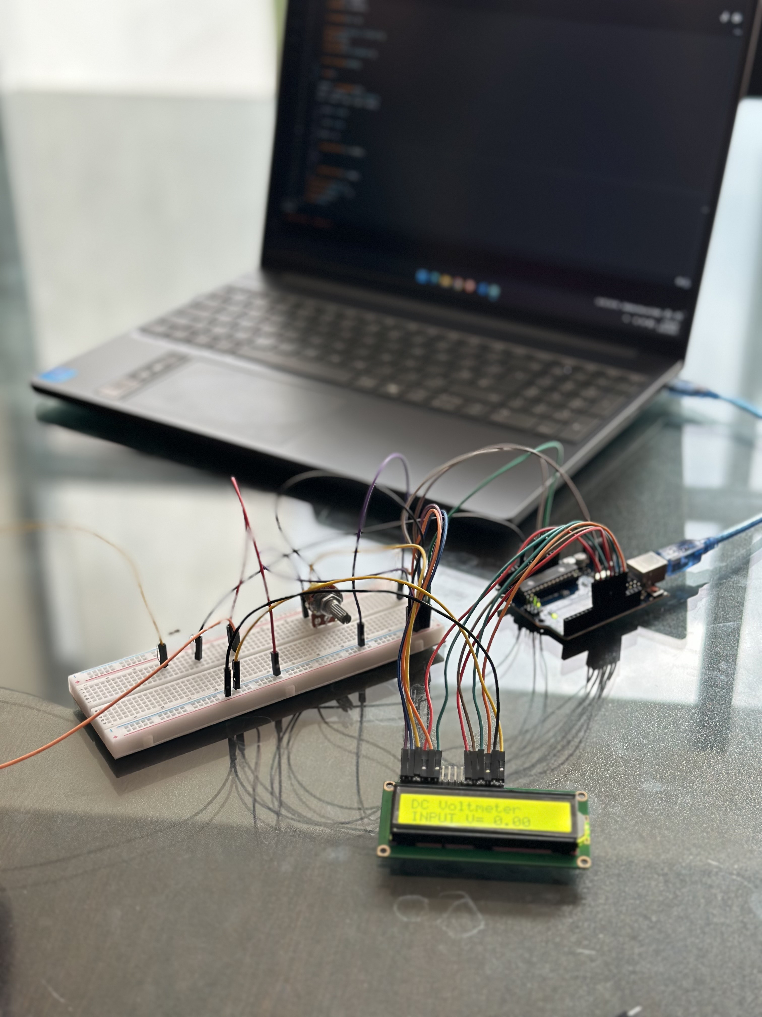
Table of Content:
Prologue
Circuit Components
Circuit Diagram
Code
Mechanism
Results and Applications

Slide 4
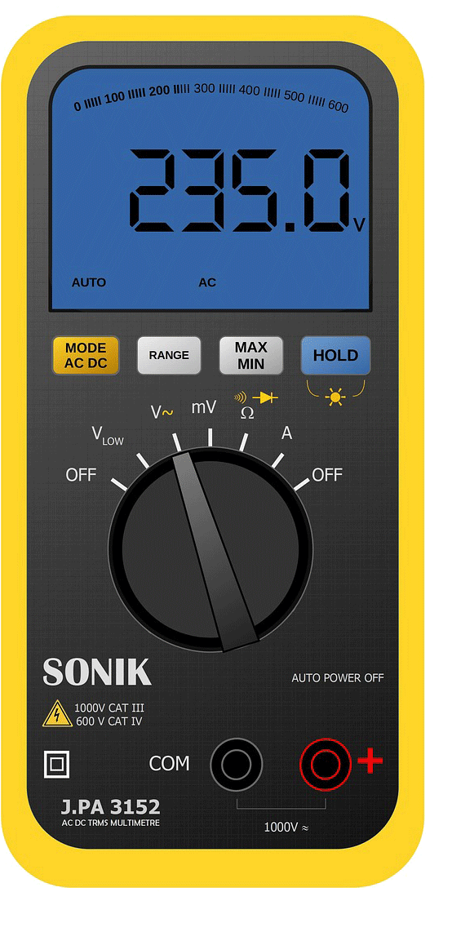
Prologue
What is a voltmeter?
A voltmeter (or multimeter in voltage mode) is an instrument used to measure the potential difference between two points in a circuit.
How was it built in this project?
A voltage divider circuit uses two resistors connected in series across a voltage source. The output voltage is taken from the junction of the resistors, which provides only a fraction of the input voltage based on the resistor ratio. To make a voltmeter, an Arduino is connected in parallel with one resistor, and the large resistance (the divider) scales the input voltage down to a measurable range. This principle allows the built voltmeter to measure different voltage ranges accurately without damaging the components.
Multimeter in Voltage Mode

Slide 5
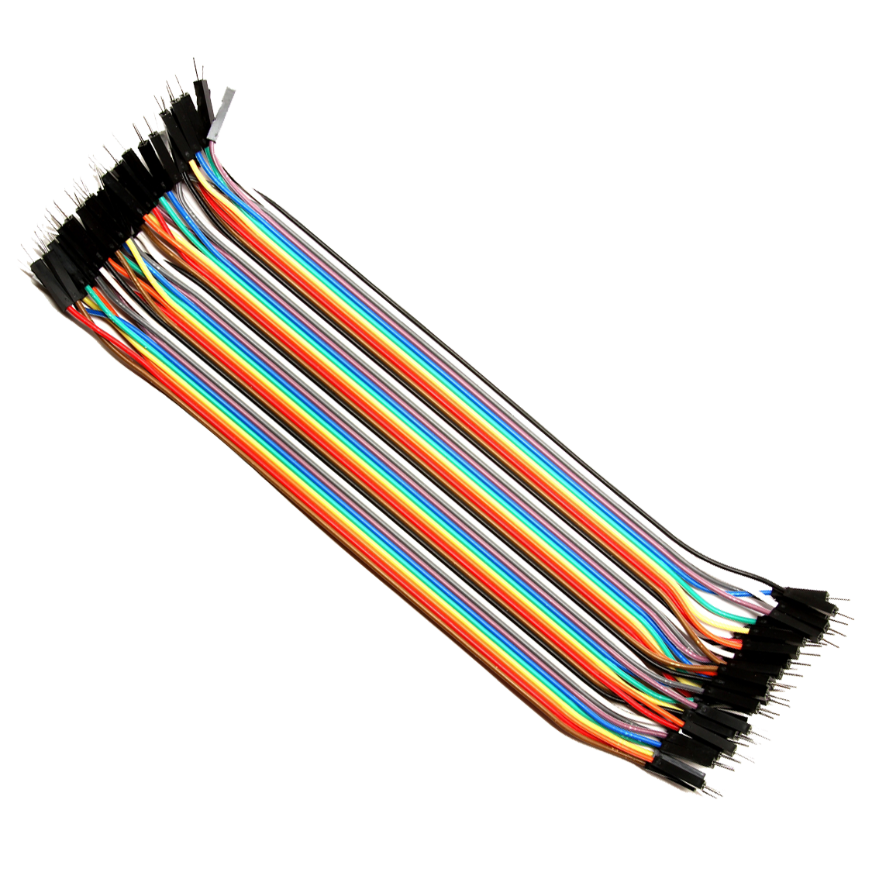
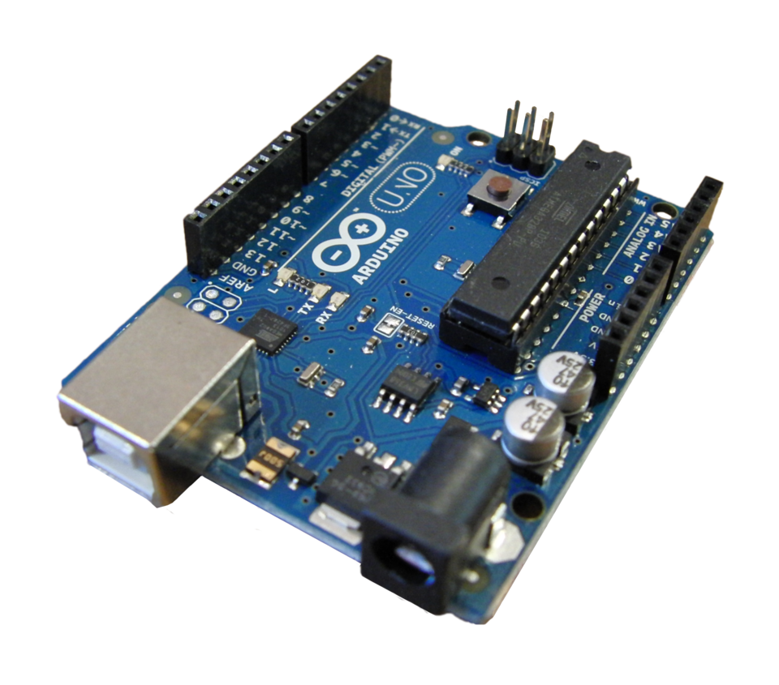
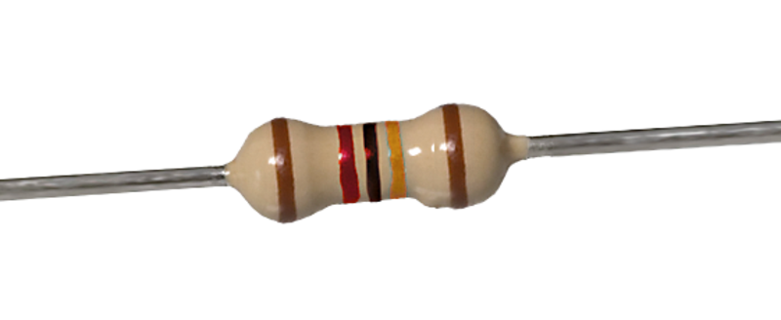
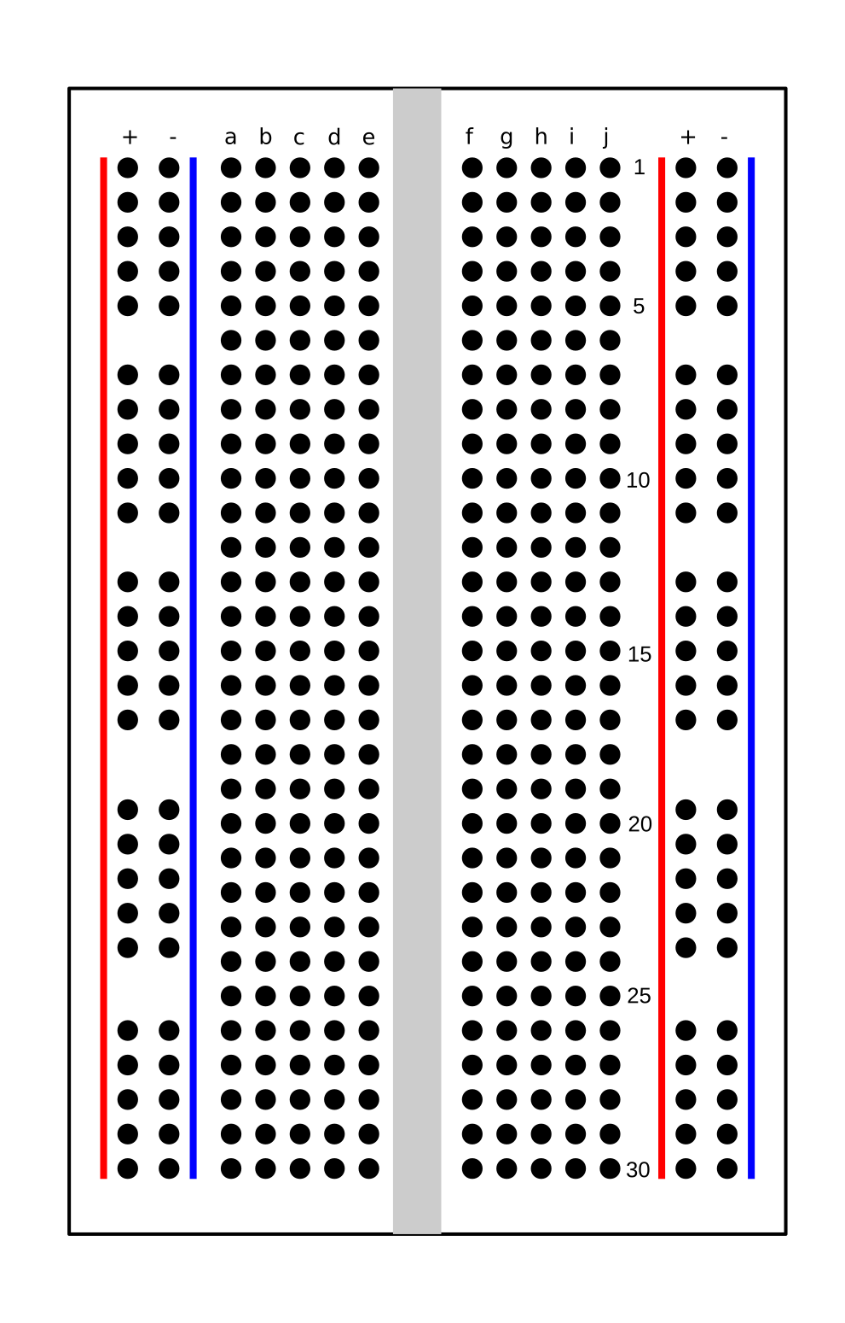
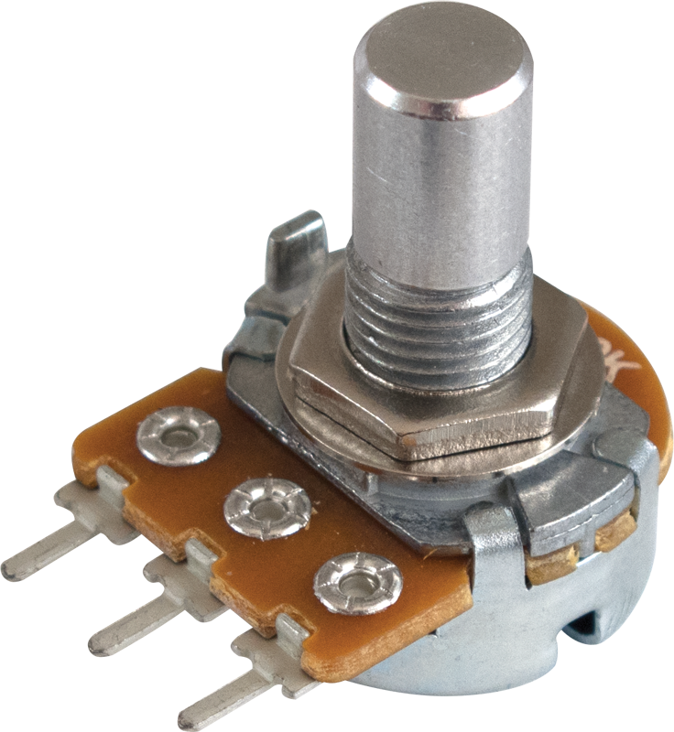
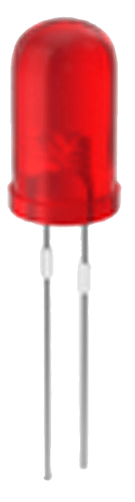
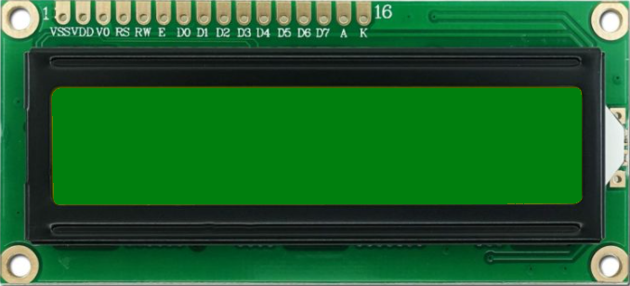
Components
Resistor (220, 10k, 100k)
Jumper Wire (M-F and M-M)
Arduino UNO
Potentiometer (10k)
LED Bulb
16*2 LCD Display
Breadboard

Slide 6
Connections
Arduino Uno R3 | Resistor | LED(Red) | LCD | Potentiometer
7 | 220 | (+)ve
8 |  |  | RS
9 |  |  | E
10 |  |  | DB4
11 |  |  | DB5
12 |  |  | DB6
13 |  |  | DB7
5V | 220 |  | BLK, VCC | (+)ve
GND |  | (-)ve | RW, BLA, GND | (-)ve
A0 | 10K(-), 100K(+)
 |  |  | V0 | MIDDLE TERMINAL

Slide 7
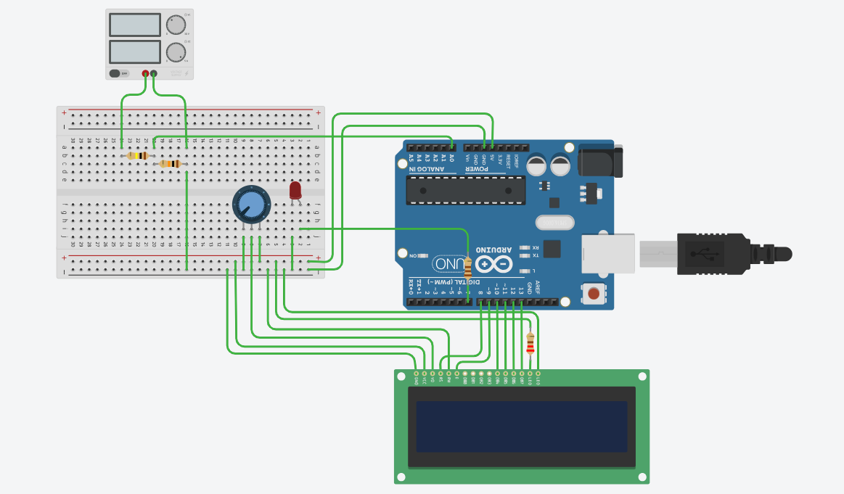
Circuit Diagram

Slide 8
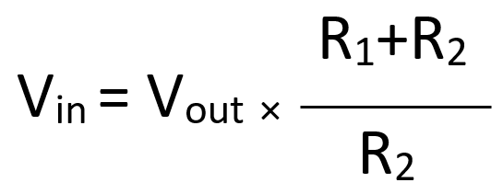
Mechanism
Arduino’s analog input pins (A0–A5) can only measure voltages from 0 to 5 V
However, a voltage divider circuit is made of two resistors in series (R1 and R2). The higher voltage is applied across both resistors, and the Arduino reads the voltage across the lower resistor (R2).
Let, Vin is the external voltage to be measured. Vout is the scaled voltage safe for Arduino. The input voltage (Vin) is divided down by the resistor ratio so the Arduino sees only a portion of it.
The Arduino’s ADC (Analog-to-Digital Converter) converts this Vout (0–5V) into a digital value (0–1023 for 10-bit ADC).
In code, the Arduino scales the ADC reading back up using the resistor ratio found by voltage divider law:
​

Slide 9
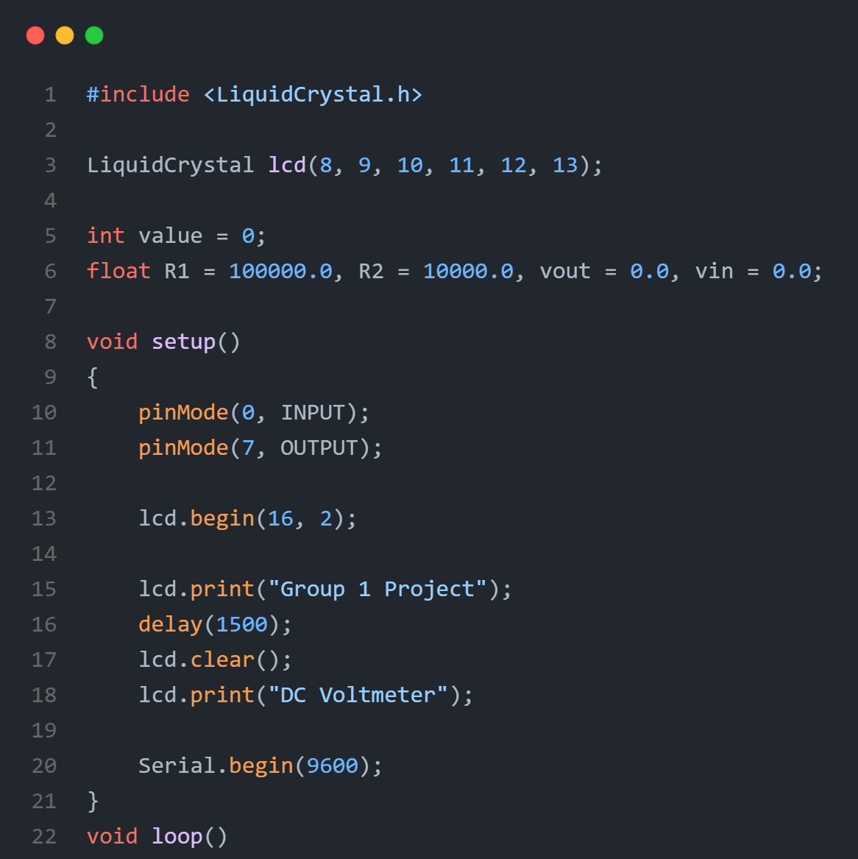
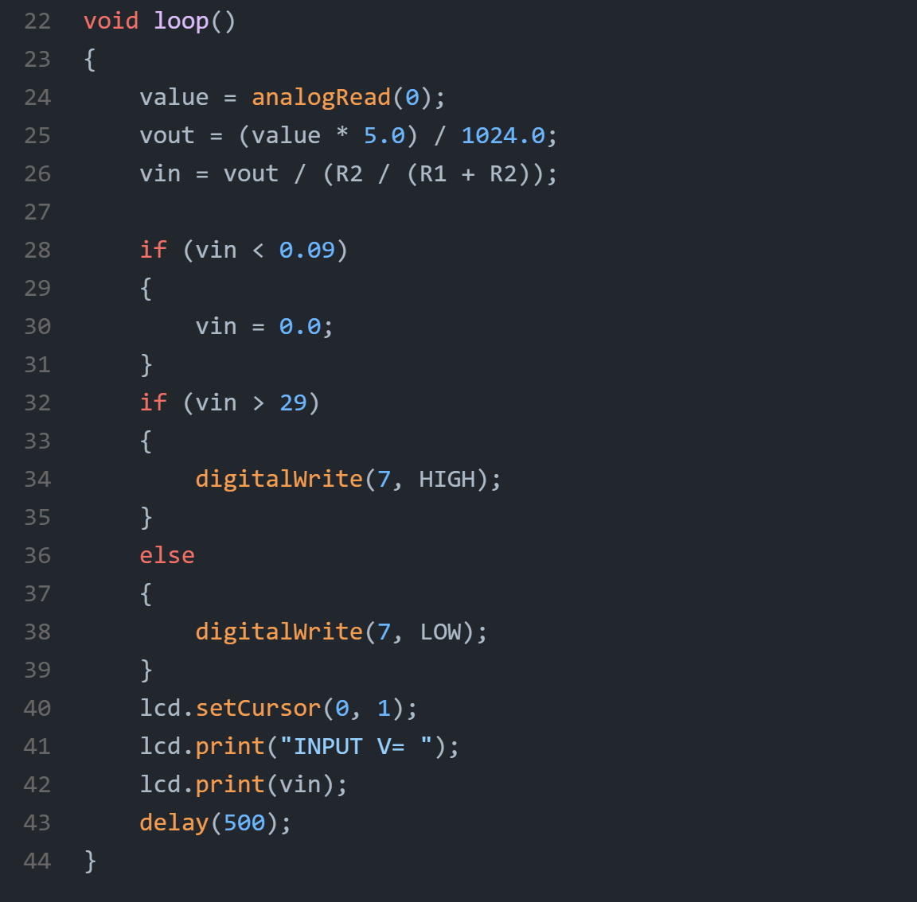
Code

Slide 10
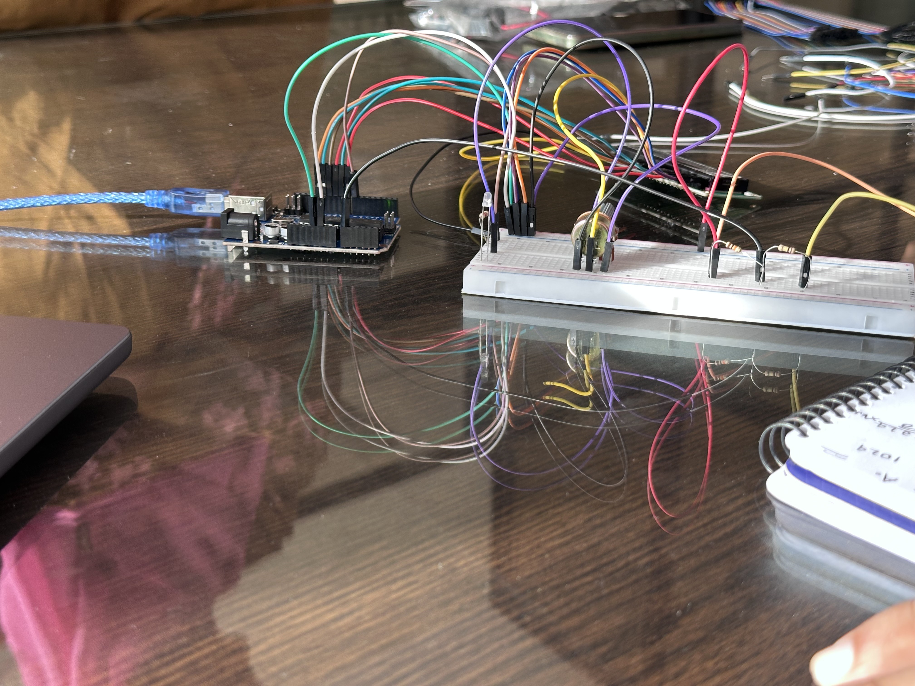
Outcomes
Analog to digital conversion
Calibration of voltage readings
LCD interfacing
Safety in voltage handling
Applications in real life
A voltmeter is used in almost all circuits in real life
Without proper voltage measurement, no electrical device can be made
Can be used to prove VDR (Voltage Divider Rule)
Can be used to measure DC voltages up to 50V

Slide 11
Future Scope
IoT Integration
Data Logging
AC Measurement
Higher Accuracy
Compact Design

Slide 12
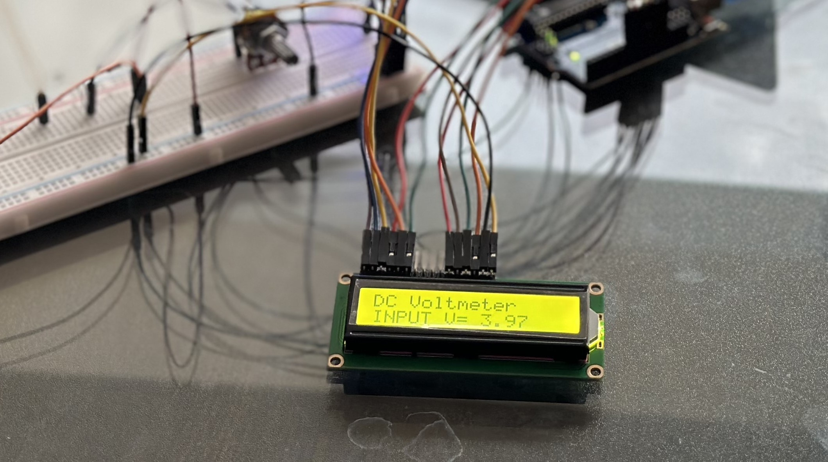
THANK YOU!

